Slide 1

Dart Programming Language
Sercan Sarman
December 2020

Slide 2
Agenda
Dart: A short history
What is Dart?
Dart 1.0
Const Objects
Domain
Readability
Other Evaluation
Platform Dependency
Dart Native
Dart Web
Flutter
Usage
IDE
Example Codes
Advantages & Disadvantages
References

Slide 3
Dart: A short history
Dart was unveiled at the GOTO conference in Aarhus, Denmark, October 10–12, 2011[1]
The project was founded by Lars Bak and Kasper Lund.[2]
Dart 1.0 was released on November 14th, 2013.[3]
Cross-browser, open source toolkit for structured web applications.
Includes:
Powerful programming language
Robust tools
Comprehensive core libraries.

Slide 4
What is Dart?
A simple and unsurprising OO programming language
Class-based single inheritance with interfaces
Optional static types
Single-threaded
Familiar syntax
Functional
Imperative

Slide 5
Dart 1.0
These pieces can help make your development workflow
Development workflow simpler
Faster
More scalable as your projects grow from a few scripts to full-fledged web applications.
SDK includes Dart Editor, a lightweight but powerful Dart development environment. In order to manage a growing code base
Code completion
Refactoring
Jump to definition
Debugger
Hints and warnings, and lots more.
Dart also offers an instant edit/refresh cycle with Dartium, a custom version of Chromium with the native Dart VM. Outside the browser, the Dart VM can also be used for asynchronous server side computation.

Slide 6
Dart 1.0
For deployment, dart2js is a translator that allows your Dart code to run in modern browsers.
The performance of generated JavaScript has improved dramatically since initial release and is in many cases getting close to that of idiomatic JavaScript
The generated JavaScript for the game Pop, Pop, Win! is now 40% smaller than it was a year ago.
Performance of the VM continues to improve as well; it’s now between 42% to 130% faster than idiomatic JavaScript running in V8, depending on the benchmark.

Slide 7
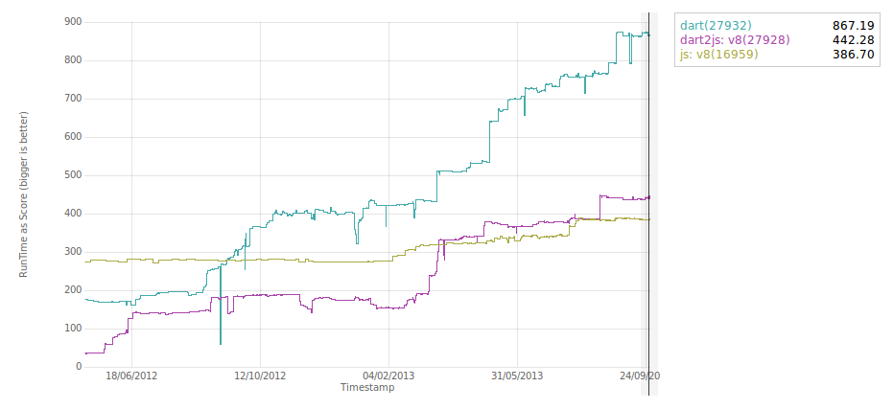
Dart 1.0
V8 is an open-source JavaScript engine developed by The Chromium Project for Google Chrome and Chromium web browsers.
DeltaBlue benchmark results

Slide 8
Dart 1.0
The Dart SDK also features the Pub package manager, with more than 500 packages from the community.
Fan favorites include AngularDart and polymer.dart, which provide higher-level frameworks for building web apps.
Dart developers can continue using their favorite JavaScript libraries with Dart-JavaScript interop.
Going forward, the Dart team will focus on improving Dartium, increasing Dart performance, and ensuring the platform remains rock solid. In particular, changes to core technologies will be backward-compatible for the foreseeable future.

Slide 9
Short History
2011-2013 Many project released from community
April 2012: Dartium for Windows is available (Chromium-based browser that includes the Dart VM). Dartium can execute Dart web apps directly, so you don't have to compile your code to JavaScript.
May 2012: Run Dart in Apache Web Server
May 2012: Native Extensions for the Standalone Dart VM
Jun 2012: Const, Static, Final keywords
Static: a member is available on the class itself instead of on instances of the class
Final: a final variable or field *must* have an initializer. Once assigned a value, a final variable's value cannot be changed.
Const: modifies *values*. You can use it when creating collections, like const [1, 2, 3], and when constructing objects (instead of new) like const Point(2, 3). Here, const means that the object's entire deep state can be determined entirely at compile time and that the object will be frozen and completely immutable.

Slide 10
Const objects [4]
They must be created from data that can be calculated at compile time. A const object does not have access to anything you would need to calculate at runtime. 1 + 2 is a valid const expression, but new DateTime.now() is not.
They are deeply, transitively immutable. If you have a final field containing a collection, that collection can still be mutable. If you have a const collection, everything in it must also be const, recursively.
They are *canonicalized*. This is sort of like string interning: for any given const value, a single const object will be created and re-used no matter how many times the const expression(s) are evaluated.

Slide 11
Const.
getConst() => const [1, 2]; main() { var a = getConst(); var b = getConst(); print(a === b); // true } I think Dart does a pretty good job of keeping the semantics and the keywords nicely clear and distinct. (There was a time where const was used both for const and final. It was confusing.) The only downside is that when you want to indicate a member that is single-assignment and on the class itself, you have to use both keywords: static final.

Slide 12
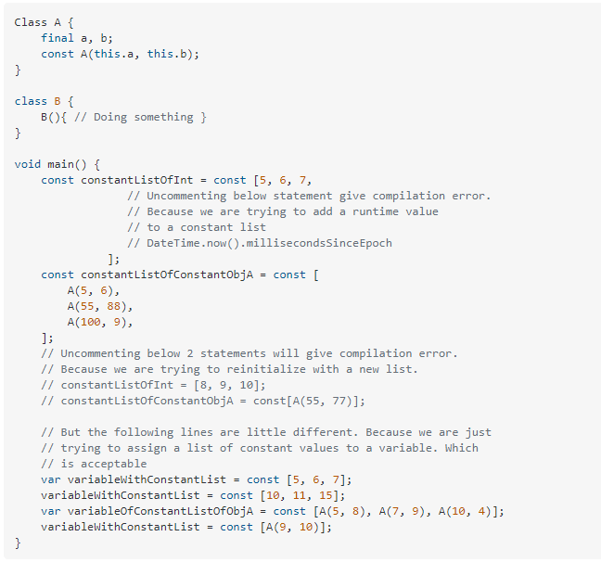
Const.

Slide 13
Short History (contd.)
July 2014, Ecma International approved the first edition of the Dart language specification at the 107th General Assembly of the international body.
December 2014, yet another edition of the Dart language specification was approved by Ecma International. Enums also introduced.
January 2015, Ecma Discussion Topics: Configurable Imports, Union Types, Generic Methods (aka polymorphic methods)
March 2015, Rest API with Dart announcement
March 2015, Enum fully supported with Dart 1.9
June 2015, Dart is on GitHub

Slide 14
Short History
August 2018, Dart 2.0 release (optimized for Client-Side development)
November 2018, Dart 2.1 release (improved performance & usability)
February 2019, Dart 2.2: Faster native code, support for set literals
November 2019, Dart 2.6: Compile Dart to self contained native executables

Slide 15
Domain
Dart is a client-optimized programming language for apps on multiple platforms.
It is developed by Google (Important for Long Term Support)
Used to build mobile, desktop, server, and web applications.
Dart is an object-oriented, class-based, garbage-collected language with C-style syntax.

Slide 16
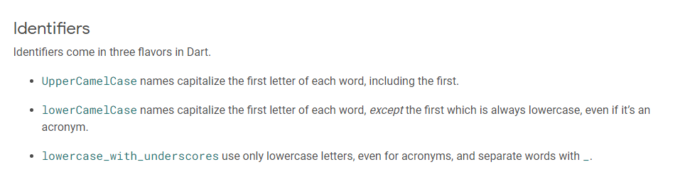
Readability

Slide 17
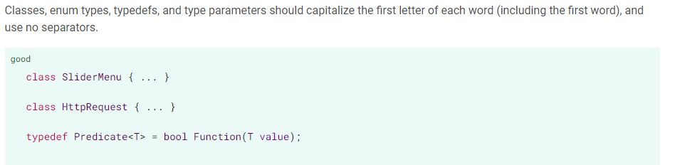
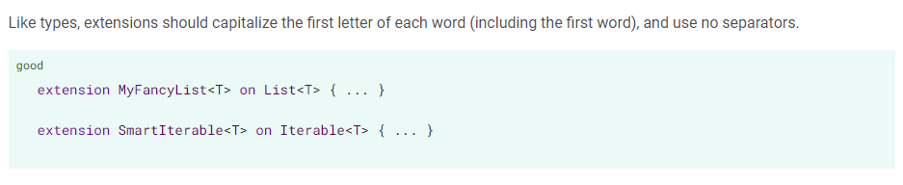
UpperCamelCase

Slide 18
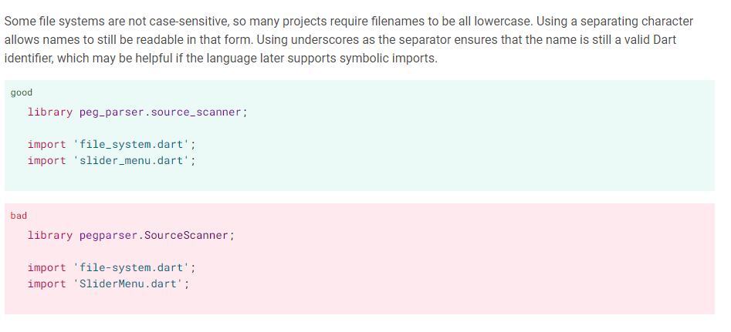
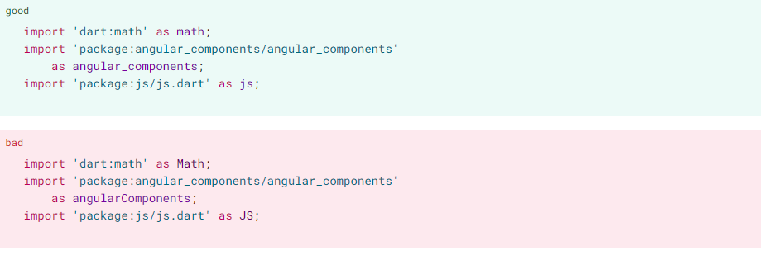
lower_case_with_underscores

Slide 19
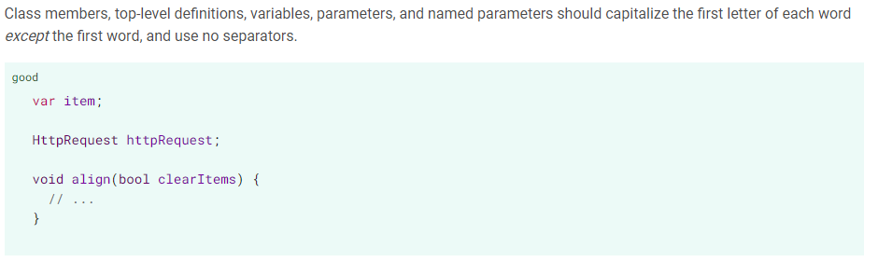
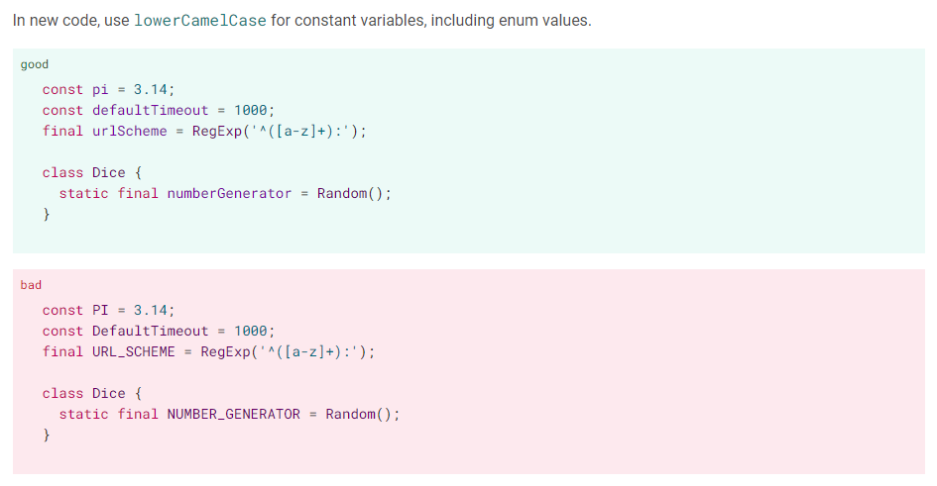
lowerCamelCase

Slide 20
Other Evaluation
Dart is compiled. Because of that, (comparing to JS), Dart is capable of finding most of the errors during compilation time, making it more type-safe than JS.
In Dart SDK version 1.9, the Dart language added asynchrony support, making asynchronous Dart code much easier to read and write.
The Dart language is type safe: it uses a combination of static type checking and runtime checks to ensure that a variable’s value always matches the variable’s static type.
Dart’s type system, like the type systems in Java and C#, is sound. It enforces that soundness using a combination of static checking (compile-time errors) and runtime checks.
For example, assigning a String to int is a compile-time error. Casting an Object to a string using as String fails with a runtime error if the object isn’t a string.

Slide 21
The benefits of soundness
A sound type system has several benefits:
Revealing type-related bugs at compile time.
A sound type system forces code to be unambiguous about its types, so type-related bugs that might be tricky to find at runtime are revealed at compile time.
More readable code.
Code is easier to read because you can rely on a value actually having the specified type. In sound Dart, types can’t lie.
More maintainable code.
With a sound type system, when you change one piece of code, the type system can warn you about the other pieces of code that just broke.
Better ahead of time (AOT) compilation.
While AOT compilation is possible without types, the generated code is much less efficient.

Slide 22
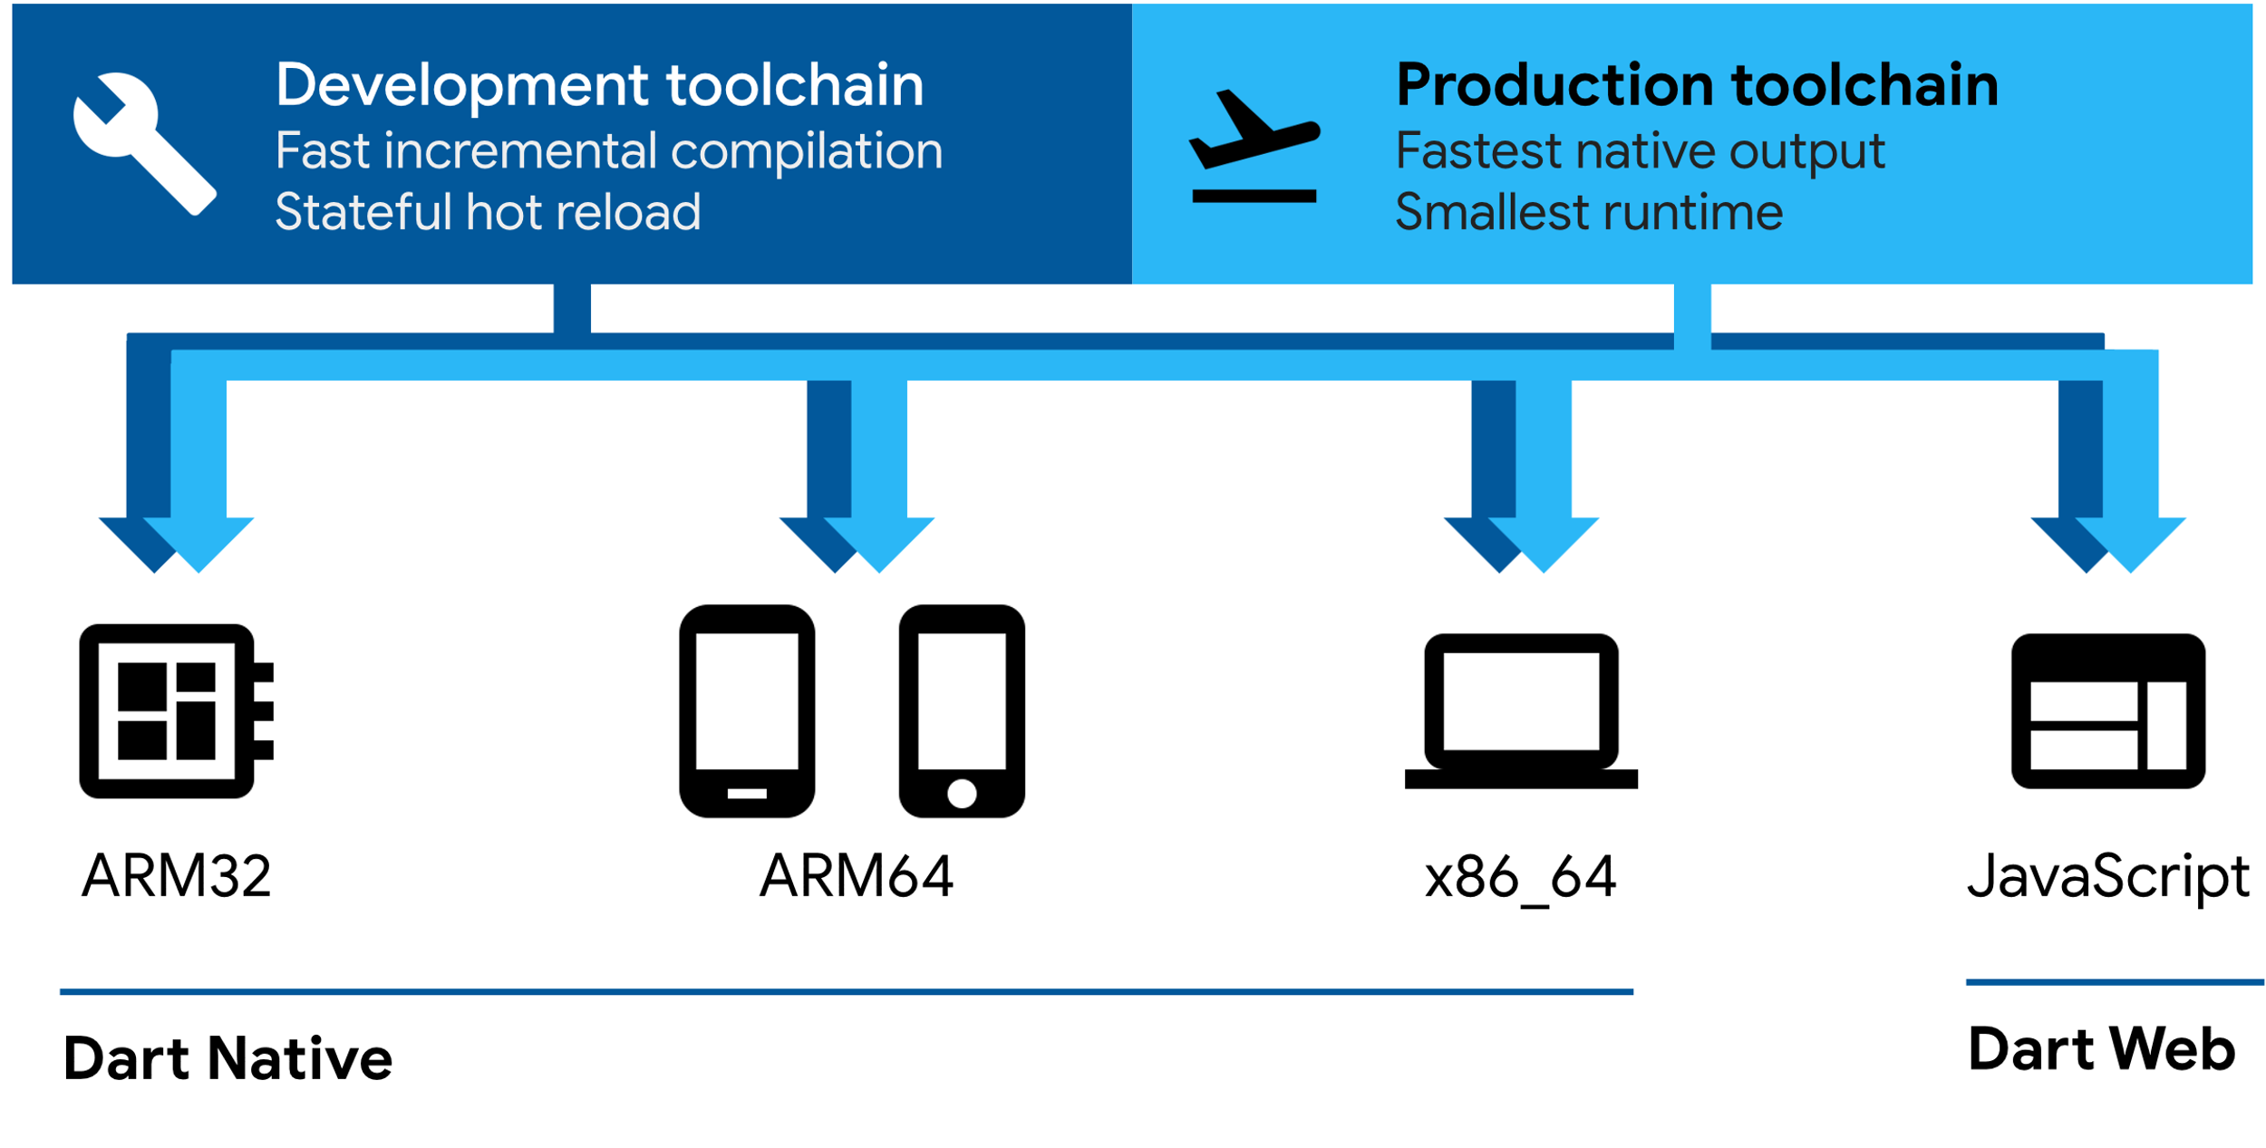
Platform Dependency
Dart Native: For programs targeting devices (mobile, desktop, server, and more), Dart Native includes both a Dart VM with JIT (just-in-time) compilation and an AOT (ahead-of-time) compiler for producing machine code.
Dart Web: For programs targeting the web, Dart Web includes both a development time compiler (dartdevc) and a production time compiler (dart2js).

Slide 23
Dart Native (VM JIT and AOT)
Dart Native enables running Dart code compiled to native ARM or X64 machine code for mobile, desktop, and server apps.
The Flutter framework is a popular multi-platform UI toolkit that’s powered by Dart Native when targeting mobile or desktop devices.
Lightning fast developer workflow (Dart VM JIT)
Having a fast developer cycle is critical for iteration.
The Dart VM has a just-in-time compiler (JIT) that supports both pure interpretation (as required on iOS devices, for example) and runtime optimization.
Optimized production code (Dart AOT)
When apps are ready to be deployed to production — whether you’re publishing to an app store or deploying to a production backend — you can use the Dart AOT compiler to ahead-of-time compile your app to native ARM or X64 code machine code. Your AOT-compiled app starts instantly and runs smoothly.
The AOT-compiled code runs inside an efficient Dart runtime that enforces the sound Dart type system and manages memory using fast object allocation and a generational garbage collector.

Slide 24
Dart Web (JavaScript)
Dart Web enables running Dart code on web platforms powered by JavaScript. With Dart Web, you compile Dart code to JavaScript code, which in turn runs in a browser — for example, V8 inside Chrome.
The Flutter framework, a popular multi-platform UI toolkit, is powered by Dart Web when targeting web apps. The AngularDart framework, a popular web app toolkit, is also powered by Dart Web.
Lightning fast developer workflow (Dart dev compiler)
The Dart dev compiler (dartdevc) is a Dart-to-JavaScript compiler that’s optimized for quick turnaround. Instead of using dartdevc directly, you use it with webdev, a tool that supports core developer tasks such as running, debugging, and building.
Optimized production code (Dart JS compiler)
The dart2js tool compiles Dart code to fast, compact, deployable JavaScript. It employs techniques such as dead-code elimination

Slide 25
Flutter
Flutter is an open-source UI software development kit created by Google.
It is used to develop applications for Android, iOS, Linux, Mac, Windows, Google Fuchsia, and the web from a single codebase.
The major components of Flutter include:
Dart platform
Flutter engine: Flutter's engine, written primarily in C++, provides low-level rendering support using Google's Skia graphics library.
Foundation library: Written in Dart, provides basic classes and functions that are used to construct applications using Flutter, such as APIs to communicate with the engine.
Design-specific widgets: Material Design widgets implement Google's design language of the same name, and Cupertino widgets implement Apple's iOS Human interface guidelines.

Slide 26
Usage
There are four ways to run Dart code:
Compiled as JavaScript: To run in mainstream web browsers, Dart relies on a source-to-source compiler to JavaScript.
Stand-alone: The Dart software development kit (SDK) ships with a stand-alone Dart VM, allowing Dart code to run in a command-line interface environment.
Ahead-of-time compiled: Dart code can be AOT-compiled into machine code (native instruction sets). Apps built with Flutter, a mobile app SDK built with Dart, are deployed to app stores as AOT-compiled Dart code.
Native: Dart 2.6 with dart2native compiler to compile to self-contained, native executables code. Before Dart 2.6, this feature only exposed this capability on iOS and Android mobile devices via Flutter.

Slide 27
IDE
November 2011: Dart Editor (based on Eclipse components)
August 2012: Eclipse plugin for Dart development
April 2015: Dart editor is announced to be retired, IntelliJ is recommended IDE for language

Slide 28

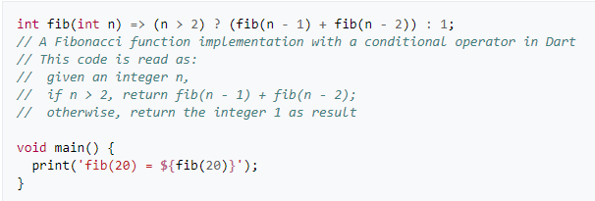
Example code
Hello World
Calculating nth Fibonacci Number

Slide 29
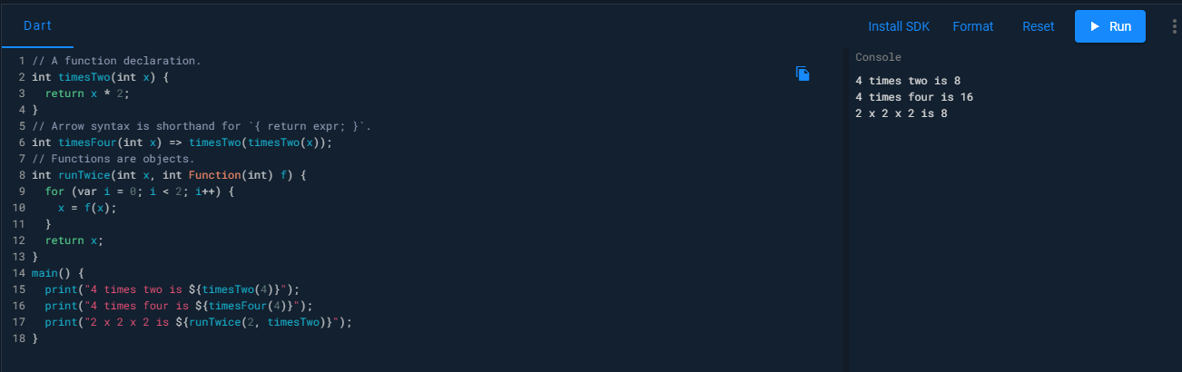
Example code
Functions

Slide 30
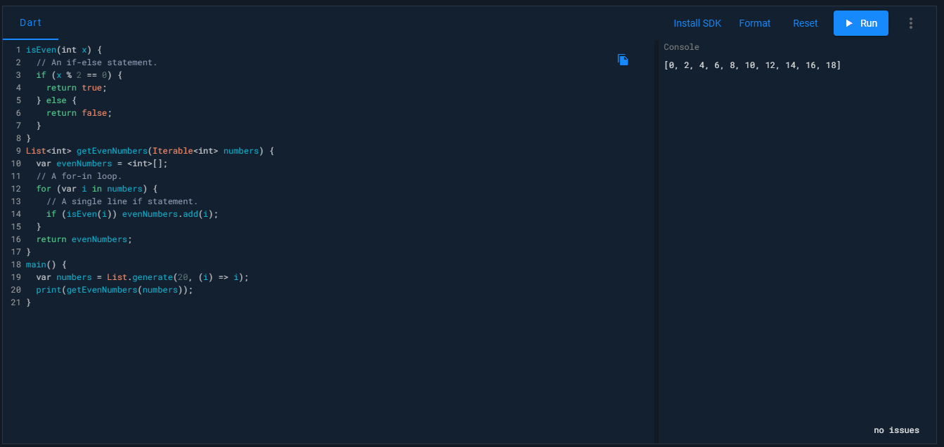
Example code
Control Flow

Slide 31
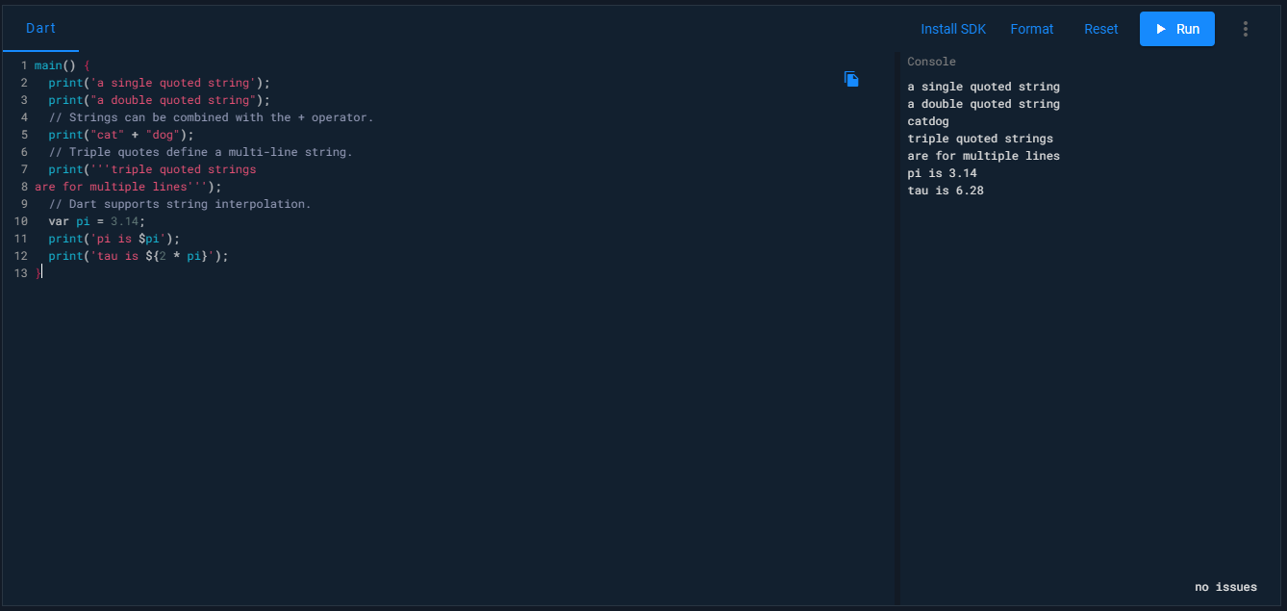
Example code
Strings

Slide 32
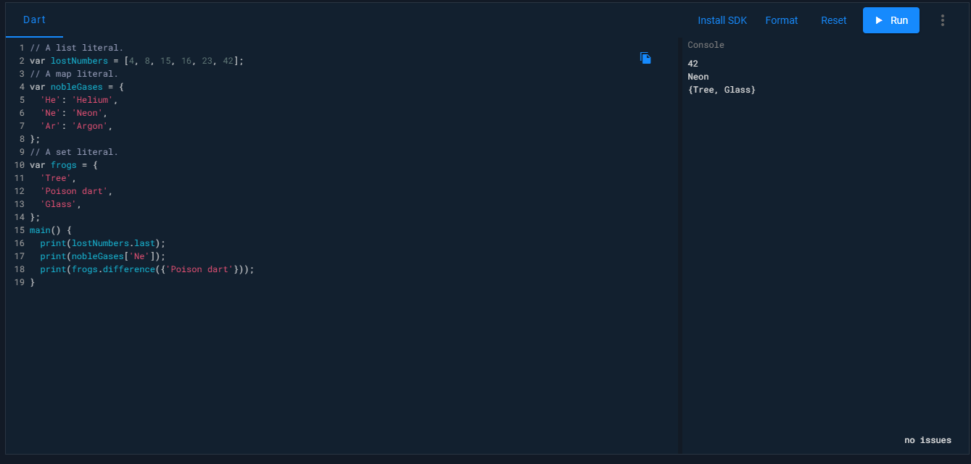
Example code
Collection Literals

Slide 33
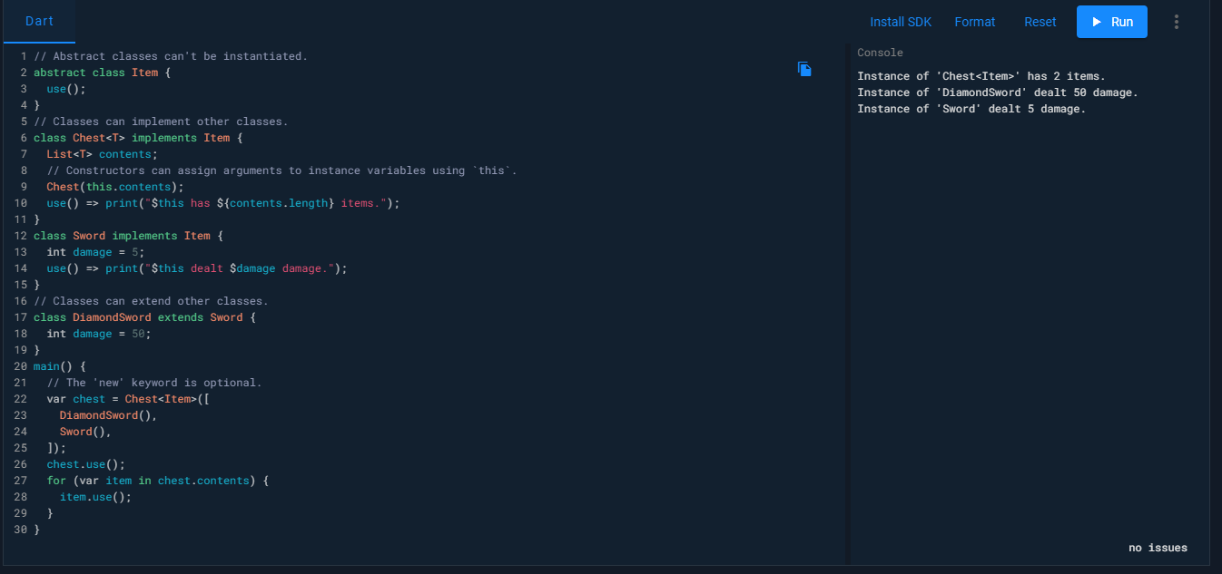
Example code
Classes

Slide 34
Advantages & Disadvantages
Open source
Backed by a large company — Google
Typesafe and compiled with JIT and AOT.
Backbone of Flutter
Relatively faster in certain instances
Cross platform
OO principles included
No licensing
Relatively new to programmers
Learning materials are not widely available compared to JavaScript

Slide 35
References
[1] "Opening Keynote: Dart, a new programming language for structured web programming“
[2] Ladd, Seth. "What is Dart". What is Dart?. O'Reilly. Retrieved August 16, 2014.
[3] Dart 1.0: A stable SDK for structured web apps". news.dartlang.org
[4] https://news.dartlang.org/2012/06/const-static-final-oh-my.html
[5] https://dart.dev/platforms
[6] https://www.concettolabs.com/blog/flutter-single-codebase-application-for-ios-and-android/
[7] https://dart.dev/
[8] https://medium.com/dartlang
[9] https://stackoverflow.com/questions/50431055/what-is-the-difference-between-the-const-and-final-keywords-in-dart

